Slide 1
Project
Andreas Sauter 747830
Julio Rodriguez 747775

Slide 2
CAN Communication with Arduino
Objective
Description
Establish the communication between Arduino and a CAN-Bus
Communicate wirelessly with a mobile device (Bluetooth)
Microcontroller as processing unit
Open-source hardware components
Hochschule Esslingen

Slide 3
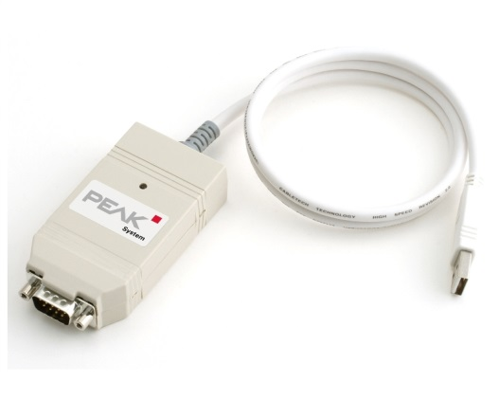
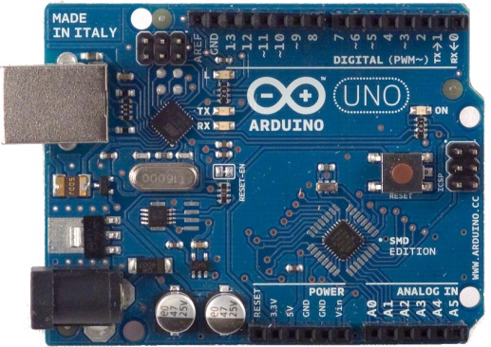
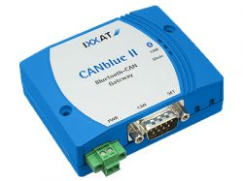
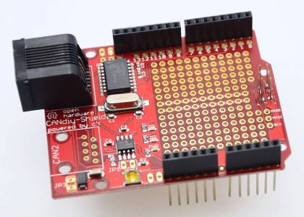
Components
ArduinoUNO
Arduino Shield, CANdiy Shield for Arduino
PCAN
CAN Blue II
Hochschule Esslingen

Slide 4
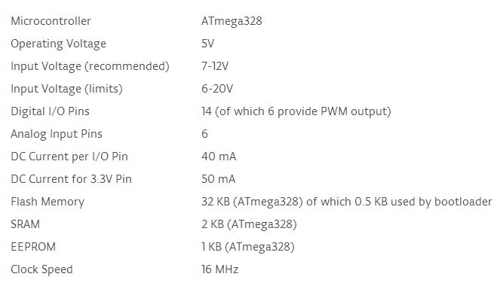
Arduino UNO
Hochschule Esslingen

Slide 5
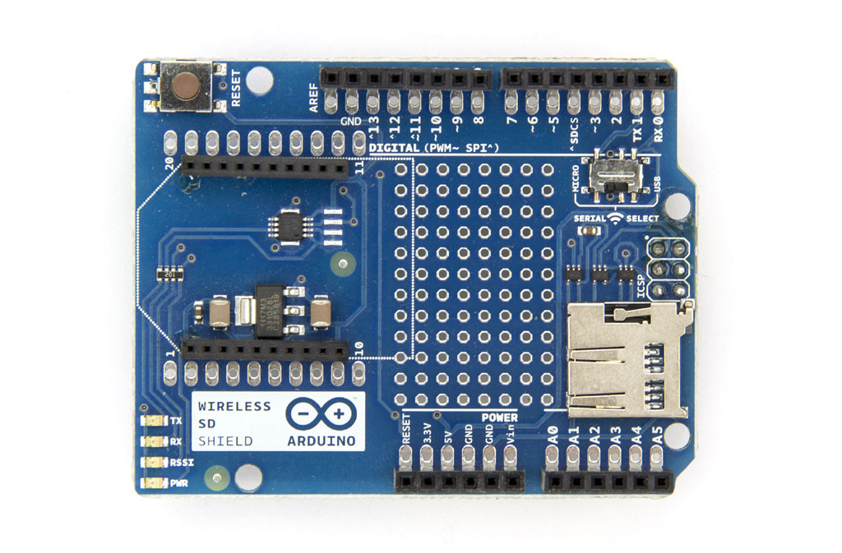
CANdiy Shield for Arduino
Open-Source hardware
Add-on hardware for specific application
Compatible with different Arduino boards
Hochschule Esslingen

Slide 6
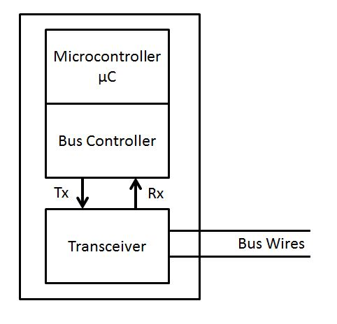
Block Diagram
Shield Components
CAN Controller (MSP 2515)
CAN Transceiver (MSP 2551)
Hochschule Esslingen

Slide 7
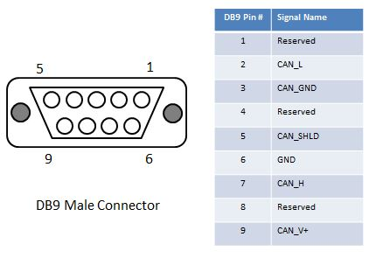
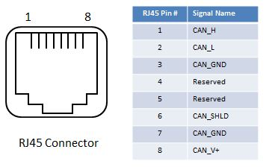
CAN Bus Communication
Physical connection
Controller configuration
Hochschule Esslingen

Slide 8
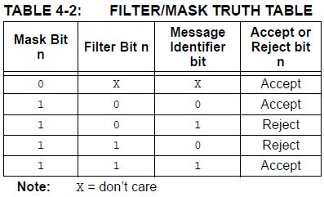
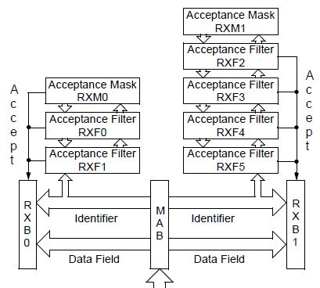
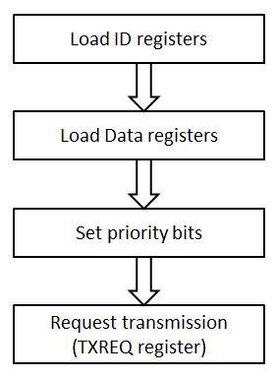
CAN Controller
Operation Mode
Receiving Messages
Sending Messages
Bit Timing and Synchronization
Hochschule Esslingen

Slide 9
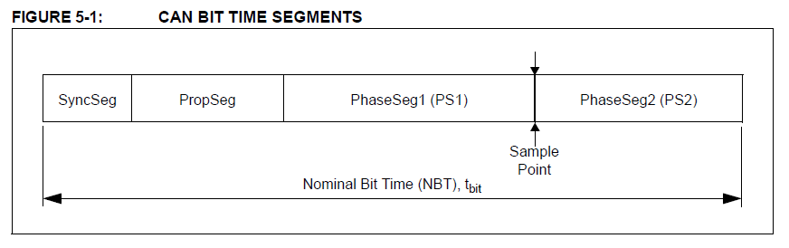
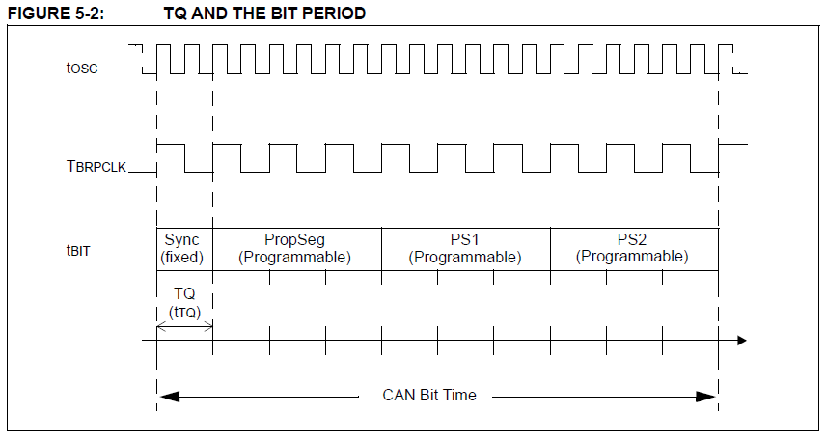
Bit Timing and Synchronization
Hochschule Esslingen

Slide 10
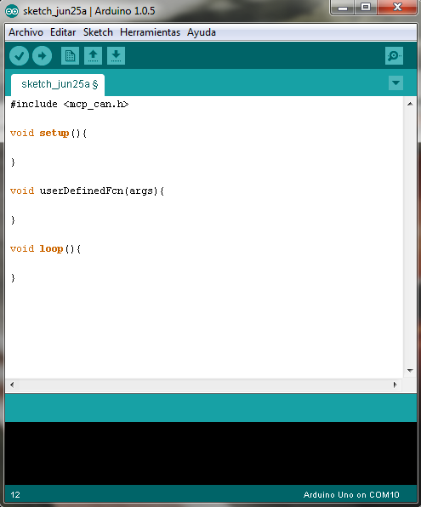
Arduino UNO
Libraries for specific application
Script structure
Java based “IDE”
Based on Processing prgramming language
Hochschule Esslingen

Slide 11
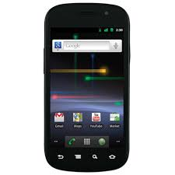
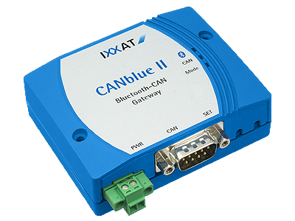
Objective
Objective:
  Create an android app to communicate via Bluetooth to the CANBlue II device
1 – Bluetooth
2 – NFC
3 – Smartphone App
Hochschule Esslingen

Slide 12

Bluetooth
What is Bluetooth?
  Wireless technology standard
  Exchange data over short distance
  Invented by Ericsson 1994
  Bluetooth Special Interest Group
    Intel, Microsoft, Nokia, IBM,…
  Was planned as wireless alternative to RS232
Used for:
  Data exchange
  Hands-free phone system (car/daily life)
  Audio transmission
Hochschule Esslingen

Slide 13
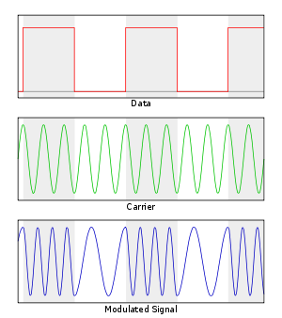
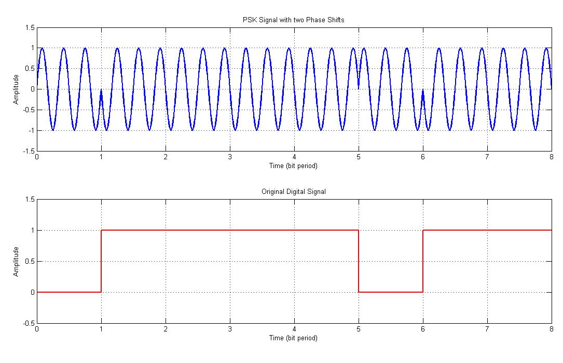
Bluetooth
Technical data:
  Frequency band 2.4 to 2.485 GHz
  Data Rates depend on BT version
    1 Mbit/s to 24 Mbit/s
  Modulation: FSK + PSK
  Range depends on application
    Up to 100m
  Master-Slave structure
  1 Master → up to 7 slaves
  Devices can switch roles in between
Hochschule Esslingen

Slide 14
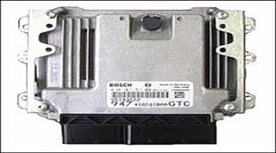
Bluetooth
Pairing and Bonding:
  Private data or control the device
  For security reason (pairing with code)
  Comfortable: establish connection (enter range)
  Mostly done manually
  Problem: several CANBlue II devices
?
Hochschule Esslingen

Slide 15

Bluetooth
Solution: Pairing with NFC
NFC
Hochschule Esslingen

Slide 16

NFC
What is NFC?
  Set of standards by NFC Forum
  Wireless communication
  Based on RFID
  Difference: passive and
  active component can change
Used for:
  Contactless transactions (smartphone)
  Data exchange
  Setup of more complex communications (Wi-Fi, BT)
Hochschule Esslingen

Slide 17
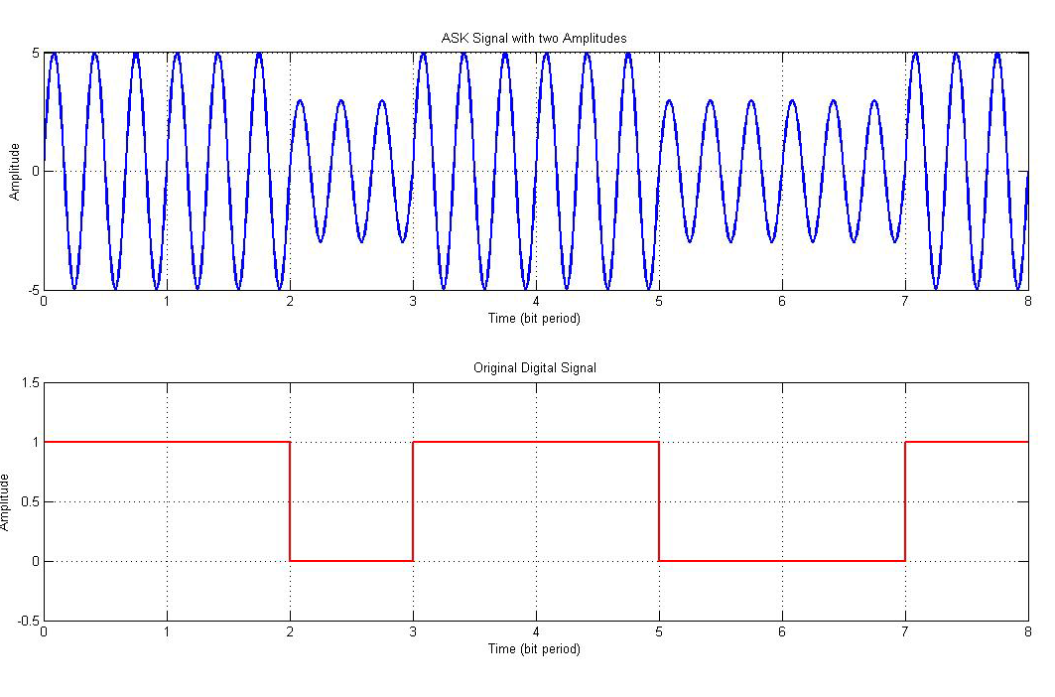
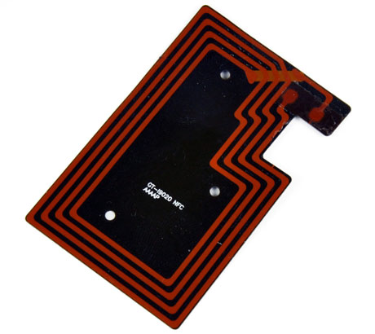
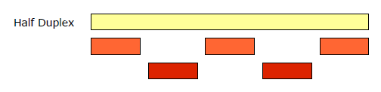
NFC
Technical data:
  Frequency of 13.56 MHz
  Data Rates:106, 212 or 424 kbit/s
  Modulation: Amplitude Shift Keying
  Range up to 10 cm
  Exchange of waves with NFC antennas
  Like coil with 4 windings
  Power component with inductivity
  Half Duplex Mode
Hochschule Esslingen

Slide 18
NFC
NFC Tags
  Small NFC antennas
  Able to store specific commands
  1 Kbyte memory
  Programmable with smartphone app via NFC
  Different things can be done:
    Send plain text
    Start an installed app
    Pair Bluetooth device with MAC address
In this Project: Pair with CANBlue II
Hochschule Esslingen

Slide 19
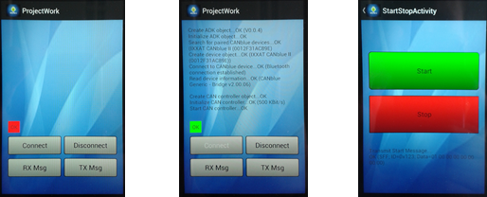
Android App
Android Application:
2 Different Payloads to start and stop:
  0x00 → stop
  0x01 → start
Hochschule Esslingen

Slide 20

Thank you for your
attention!
Hochschule Esslingen

